Slide 1
Credit Default Analysis
Akanksha Jain

Slide 2
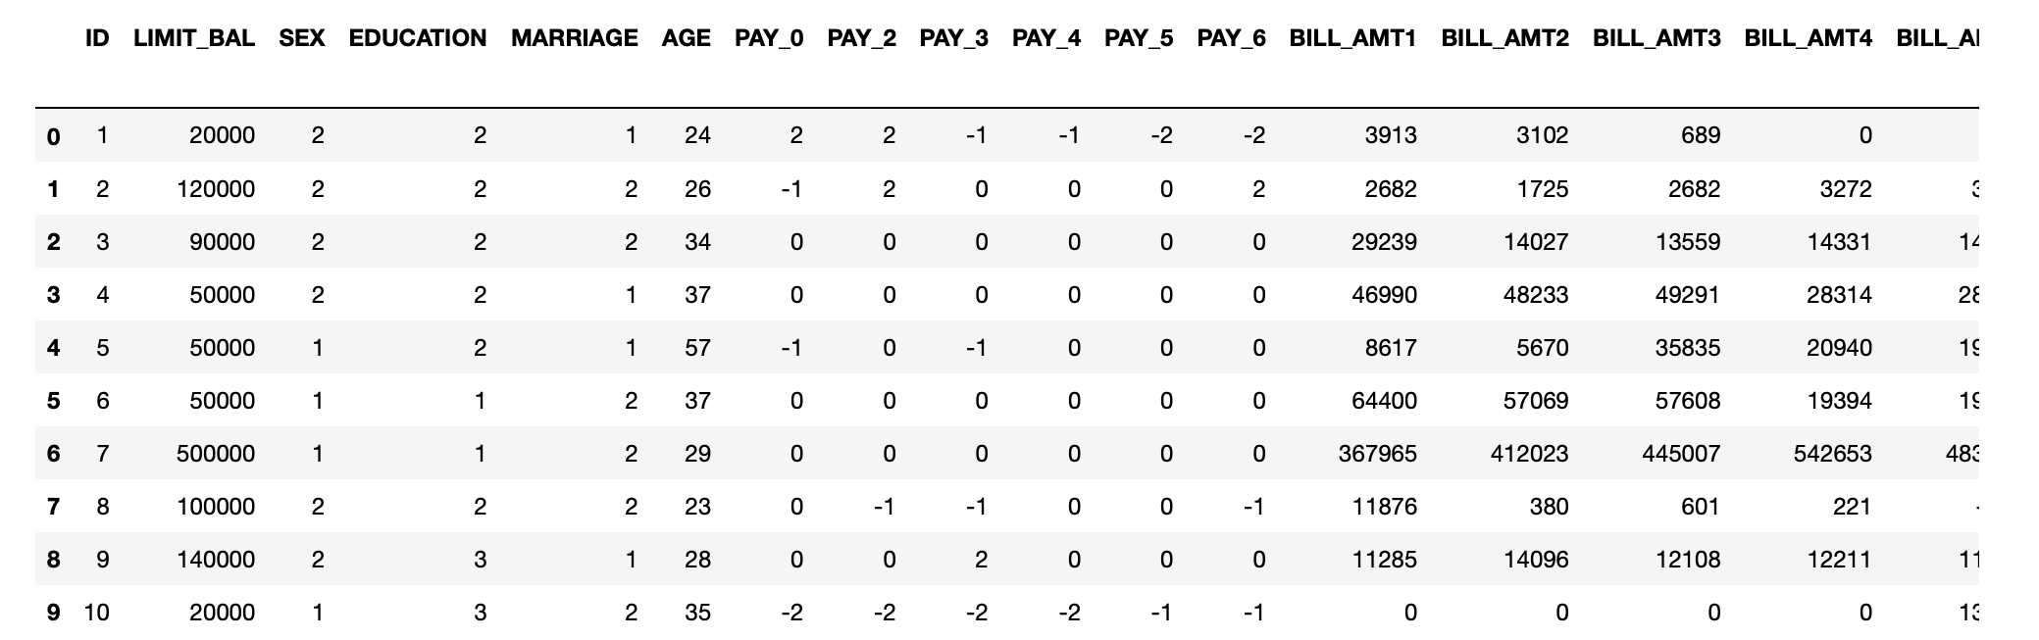
Problem statement
Determine client characteristic who are likely to default on their next months credit card payment so that selling cards only to clients who are likely to pay the bills and reduce risk.

Slide 3
Overview
Dataset from UCI Machine Learning Repository: Default of credit card client dataset
Code on Github: Credit_card_default
30000 records
24 attributes
Predictors:
Demographic : Age (numeric ), Sex (category). Marriage (category). , Education (category).
Payments for six months : Pay_0 to Pay_6 (category)
Billed amount for six months: BILL_AMT1 to BILL_AMT6 (numeric)
Payment amount for six months: PAY_AMT1 to PAY_AMT6 (numeric)
Target Variable : Default (category)

Slide 4
Data Preprocessing
Missing Values: Data does not have missing values
Deleted ID column as it is irrelevant
Created age bins for visualization, not used in modeling
Changed type for categorical variables listed as numeric : Sex, Marriage, Education, Pay_0 to Pay_6 , default
Pay_0 to Pay 6. -1 and -2 are not known assuming these means payment made on time replace -1 and -2 to 0
Education: 5 and 6 are not known, replaced to others
Marriage: 0 is not known, replaced to others
Replaced numbers for names for categorical values:
Sex: Male , Female
Education: Graduate school ,University, High school, Others
Marriage: Married, Single ,Others
Default: Yes, No
Outliers were not removed for this analysis

Slide 5
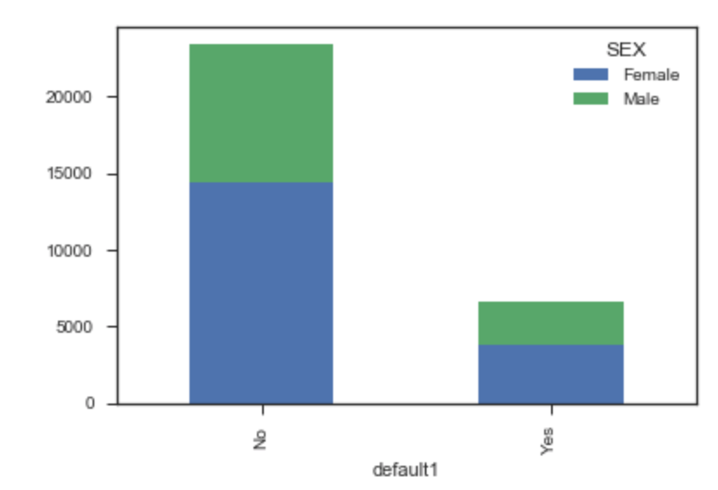
Data Exploration
Average age is 35 years and average credit amount is $167,484.322
Over 50% of the clients are females.
Majority clients have university degree
Over 50% of the clients are single
Over 75% of the clients made six months payment (atleast min amount due) on time
Correlation was high for billed amounts for all six months. No other attributes were correlated

Slide 6
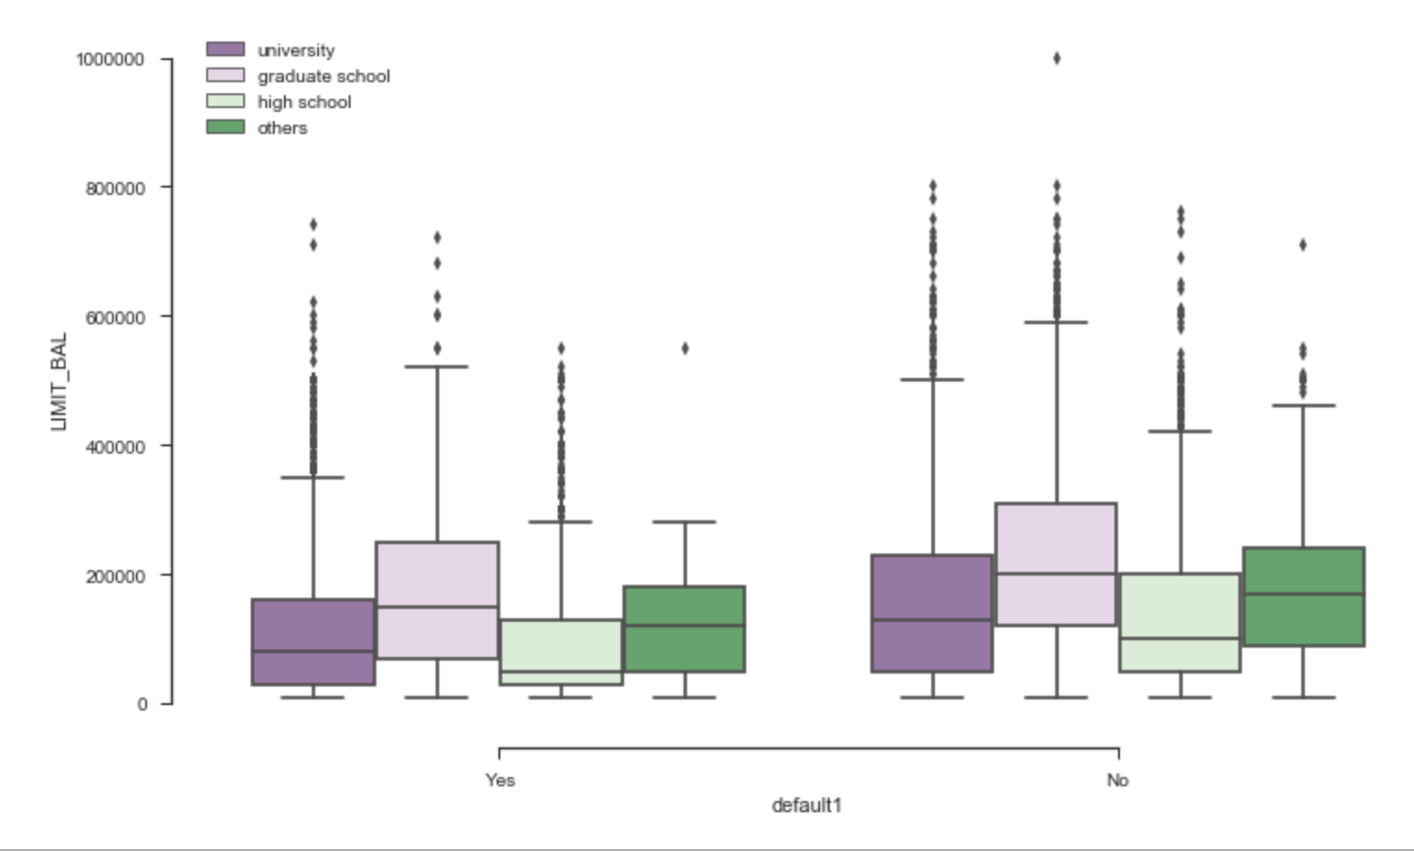
Data Exploration
Average Credit of clients who defaulted was $130,109
Females clients had higher credit limit of $ 170k compared to 163k for males clients
25 % of clients with high school diploma defaulted
23.7% of clients with university degree defaulted
19% of clients with grad school degree defaulted

Slide 7
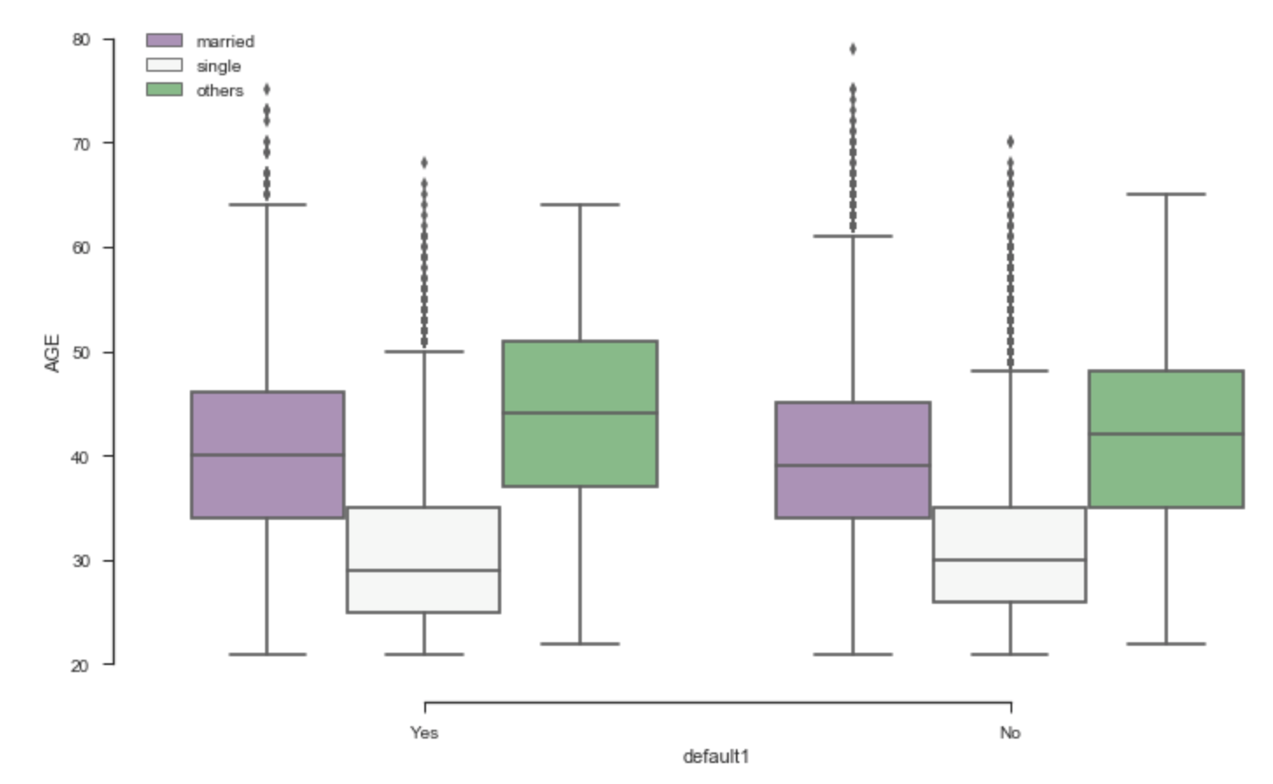
Data Exploration
23.6% of clients with Others as martial statues defaulted but they were less than 350 clients in this category
23.4% of married clients defaulted
20.9 % of single clients defaulted

Slide 8
Predictive modeling
This was a classification problem, determining if a client with default on their next credit card statement.
Split the data into 70% training 30% testing sets
Ran 3 models Logistic Regression, Decision trees and K- Nearest neighbors with k=4.
Accuracy for the models
Logistic Regression : 78%
Decision Tree: 73%
K- Nearest neighbors : 76%

Slide 9
recommendations
Bank should consider giving cards to clients with the following features:
Clients with a high school diploma and university degree are likely to default. This may be due to low income paying jobs, unemployment. High student debt for clients with university degree.
Clients in the age range of 25yrs to 35 yrs. are also likely to default.
Data shows that married couple are likely to default than single clients.
Bank should also keep a close watch on clients who have a credit card with the above characteristics and take necessary actions to avoid the risk of a client defaulting.
Further analysis is recommended using dataset with data for more than six months to get better insights.

